Slide 1
19CSE456- NEURAL NETWORKS & DEEP LEARNING
Activation functions

Slide 2
Activation Function
Used to determine the output of neural network like yes or no
It maps the resulting values in between 0 to 1 or -1 to 1 etc. (depending upon the function).
An activation function in a neural network defines how the weighted sum of the input is transformed into an output from a node or nodes in a layer of the network.
Linear Activation Function
Non-linear Activation Functions

Slide 3
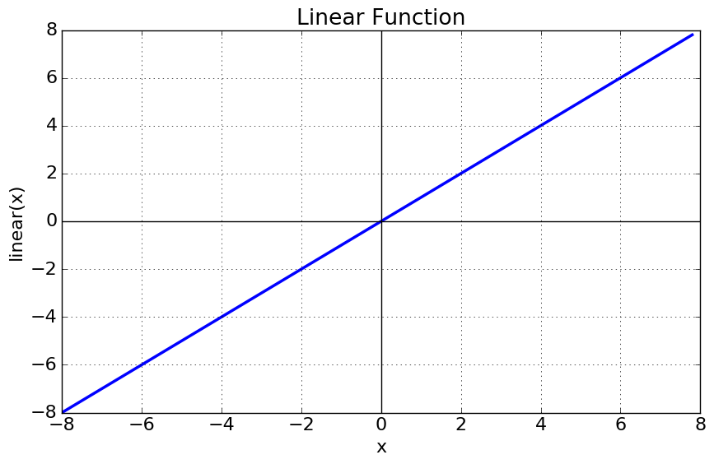
Linear or Identity Activation Function
Equation : f(x) = x
Range : (-infinity to infinity)
It doesn’t help with the complexity or various parameters of usual data that is fed to the neural networks.

Slide 4
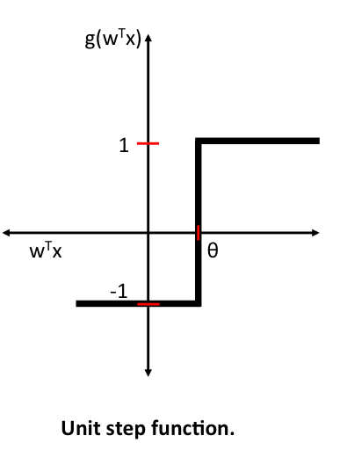
Step Activation Function
Threshold Function

Slide 5
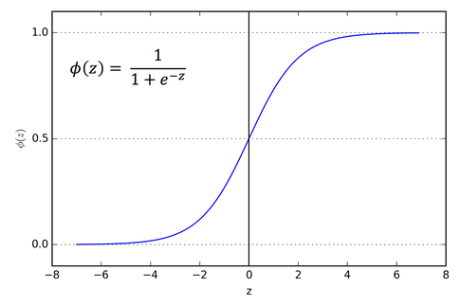
Sigmoid or Logistic Activation Function
Sigmoid function is also called the logistic function
The Sigmoid Function curve looks like a S-shape.
The function takes any real value as input and outputs values in the range 0 to 1. The larger the input (more positive), the closer the output value will be to 1.0, whereas the smaller the input (more negative), the closer the output will be to 0.0.
https://colab.research.google.com/drive/1TSBV7OpGWSizu136k65Szclc7VMEzQ73?authuser=3#scrollTo=7T_XsmSOaJR7

Slide 6
Sigmoid or Logistic Activation Function
Normally used in the output layer (Binary classification)
The function is differentiable. That means, we can find the slope of the sigmoid curve at any two points.
When using the Sigmoid function for hidden layers, it is a good practice to use a “Xavier Normal” or “Xavier Uniform” weight initialization and scale input data to the range 0-1 (e.g. the range of the activation function) prior to training.

Slide 7
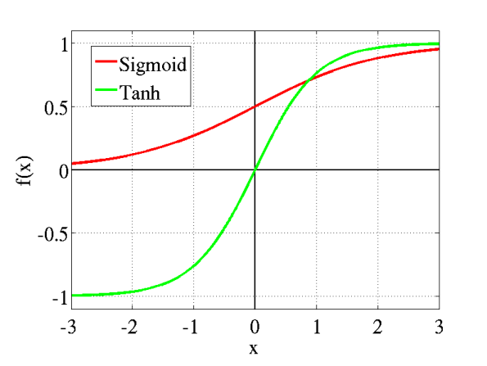
Tanh or hyperbolic tangent Activation Function
The range of the tanh function is from (-1 to 1).
The advantage is that the negative inputs will be mapped strongly negative and the zero inputs will be mapped near zero in the tanh graph
The larger the input (more positive), the closer the output value will be to 1.0, whereas the smaller the input (more negative), the closer the output will be to -1.0.
The function is differentiable.
Both tanh and logistic sigmoid activation functions are used in feed-forward nets.
(e^x – e^-x) / (e^x + e^-x)

Slide 8
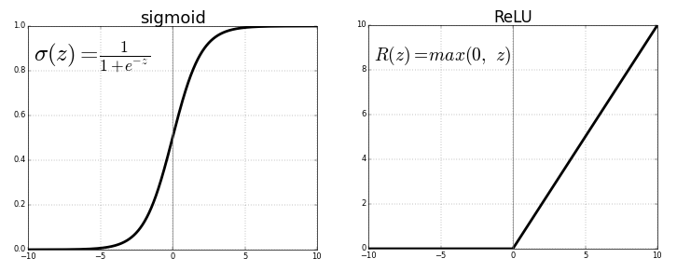
ReLU (Rectified Linear Unit) Activation Function
Most used activation function.
it is used in almost all the convolutional neural networks or deep learning
Range: [ 0 to infinity)
Problem:
All the negative values become zero immediately which decreases the ability of the model to fit or train from the data properly. That means any negative input given to the ReLU activation function turns the value into zero immediately in the graph

Slide 9
https://machinelearningmastery.com/choose-an-activation-function-for-deep-learning/
https://towardsdatascience.com/activation-functions-neural-networks-1cbd9f8d91d6
https://www.geeksforgeeks.org/activation-functions-neural-networks/

Slide 10
Thank you

